Slide 1
Teaching the machines about gentrification & equity
Ken Steif, Ph.D
Director - Master of Urban Spatial Analysis - Univ. of Pennsylvania
@KenSteif

Slide 2
Agenda
Definitions
What do machines know about housing policy?
A machine-centric approach to gentrification in Nashville
How can Nashville convert data into actionable intelligence?
@KenSteif

Slide 3
Definitions
Gentrification Mad Libs
Actors:
Home buyers
Real estate agents
Landlords
Planners/government officials
Lenders
People of a given race
Renters
Planet Earth
Mechanisms:
Changing preferences for urban living
See increased profit potential in real estate
Institutional discrimination
Government discrimination
Government intervention
A natural disaster
Economic development
Outcomes:
Displacement
A reduction in affordability
A change to the aesthetic character
Demographic change
A change to social cohesion
New amenities
New governance/politics
Changes to school quality
Gentrification is when _______ exhibit ______ leading to _______ in a neighborhood.
(actor)
(mechanism)
(outcome)
@KenSteif

Slide 4
Definitions
Gentrification Mad Libs
‘Train the machine’: What outcome is the most important for your community?
@KenSteif

Slide 5
Definitions
Machine Learning
In theory:
Machine learning borrows the experience of people or places and tests the extent which those experiences are generalizable to another set of people or places.
In practice:
If we can predict how individuals or places will respond in a certain way to an incentive, intervention or opportunity, then perhaps we can be more efficient in allocating our limited resources.
@KenSteif

Slide 6
Definitions
Machine Learning
In order for a machine to predict gentrification in a policy context it must:
1. Understand the current resource allocation process.
2. Gather labeled data about a ground-truthed and relevant outcome.
3. Gather data that might explain variation in that outcome.
4. Test predictions for out-of-sample generalizability.
5. Evaluate whether decision-making guided by the predictions leads to better outcomes compared to the ‘business-as-usual’ approach.
@KenSteif

Slide 7
Definitions
Machine Learning
What do machines know about housing policy?
Housing policy goals are complex. What labeled, ground-truthed data describe these goals?
Mixed-income neighborhood
Displacement
Equity
Fair housing
Segregation
Subsidized housing
Public Housing
Economic inequality
Economic mobility
@KenSteif

Slide 8
What do machines know about housing policy?
Instead, we are forced have to use a very limited set of outcomes including:
Home prices
Rents
Dissimilarity indices
Tenure
Evictions
Permits
Displacement
@KenSteif

Slide 9
A machine-centric approach to gentrification in Nashville
1. We’ll assume the machine doesn’t know about housing policy.
2. We’ll assume the machine has a set of generalized rules or hypothesis about what gentrification ‘looks like’.
Hypothesis 1: Households increasingly prefer urban locations over suburban locations.
Hypothesis 2: Households choose urban locations by trading off their willingness to pay for housing with their preference for accessing urban amenities.
@KenSteif

Slide 10
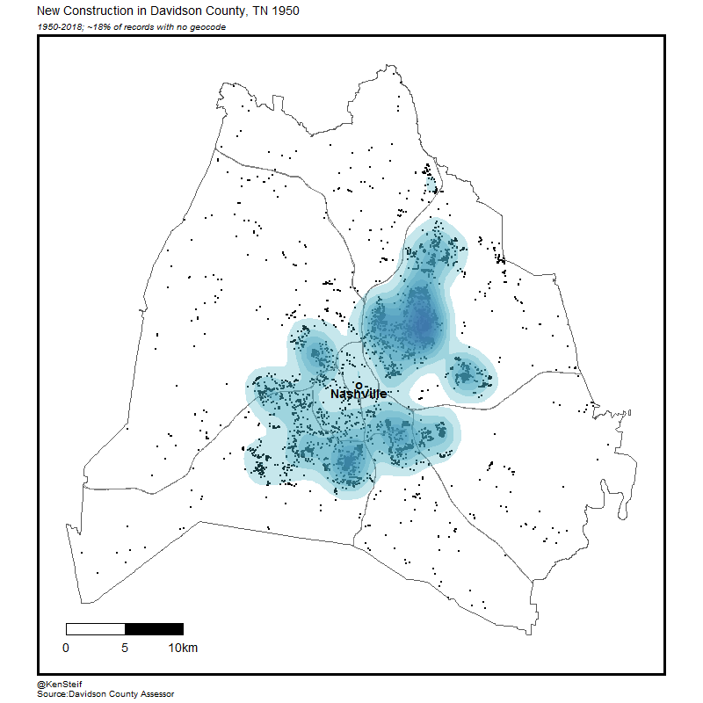
A machine-centric approach to gentrification in Nashville
Hypothesis 1: Households increasingly prefer urban locations over suburban locations.
@KenSteif

Slide 11
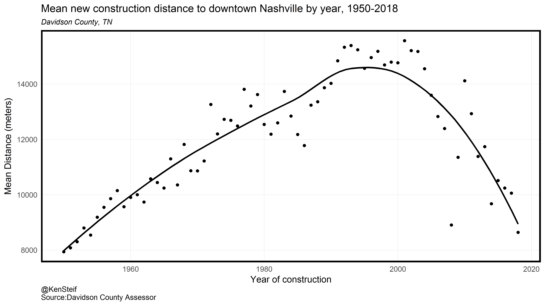
A machine-centric approach to gentrification in Nashville
Hypothesis 1: Households increasingly prefer urban locations over suburban locations.
@KenSteif

Slide 12
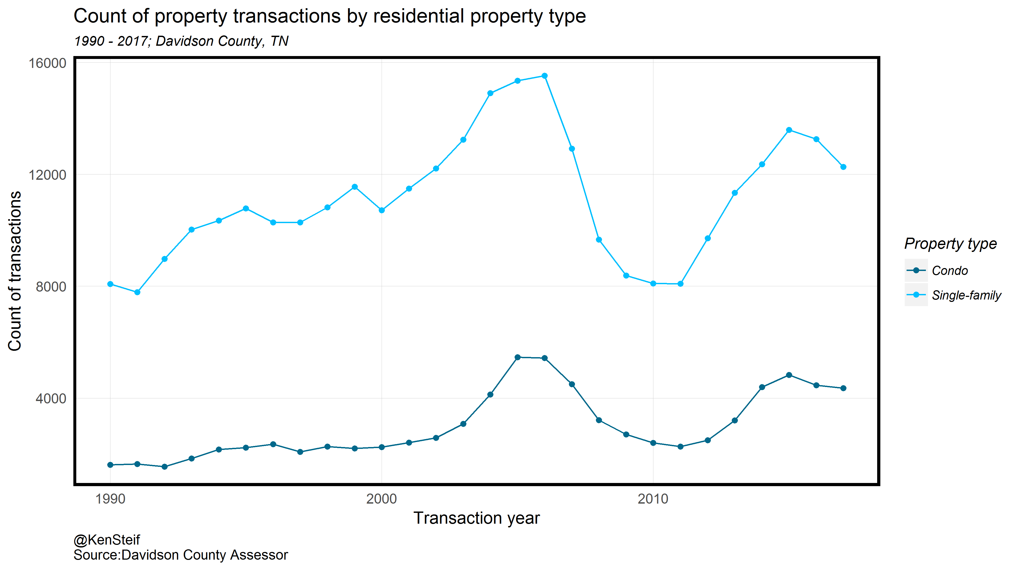
A machine-centric approach to gentrification in Nashville
Hypothesis 1: Households increasingly prefer urban locations over suburban locations.
@KenSteif

Slide 13
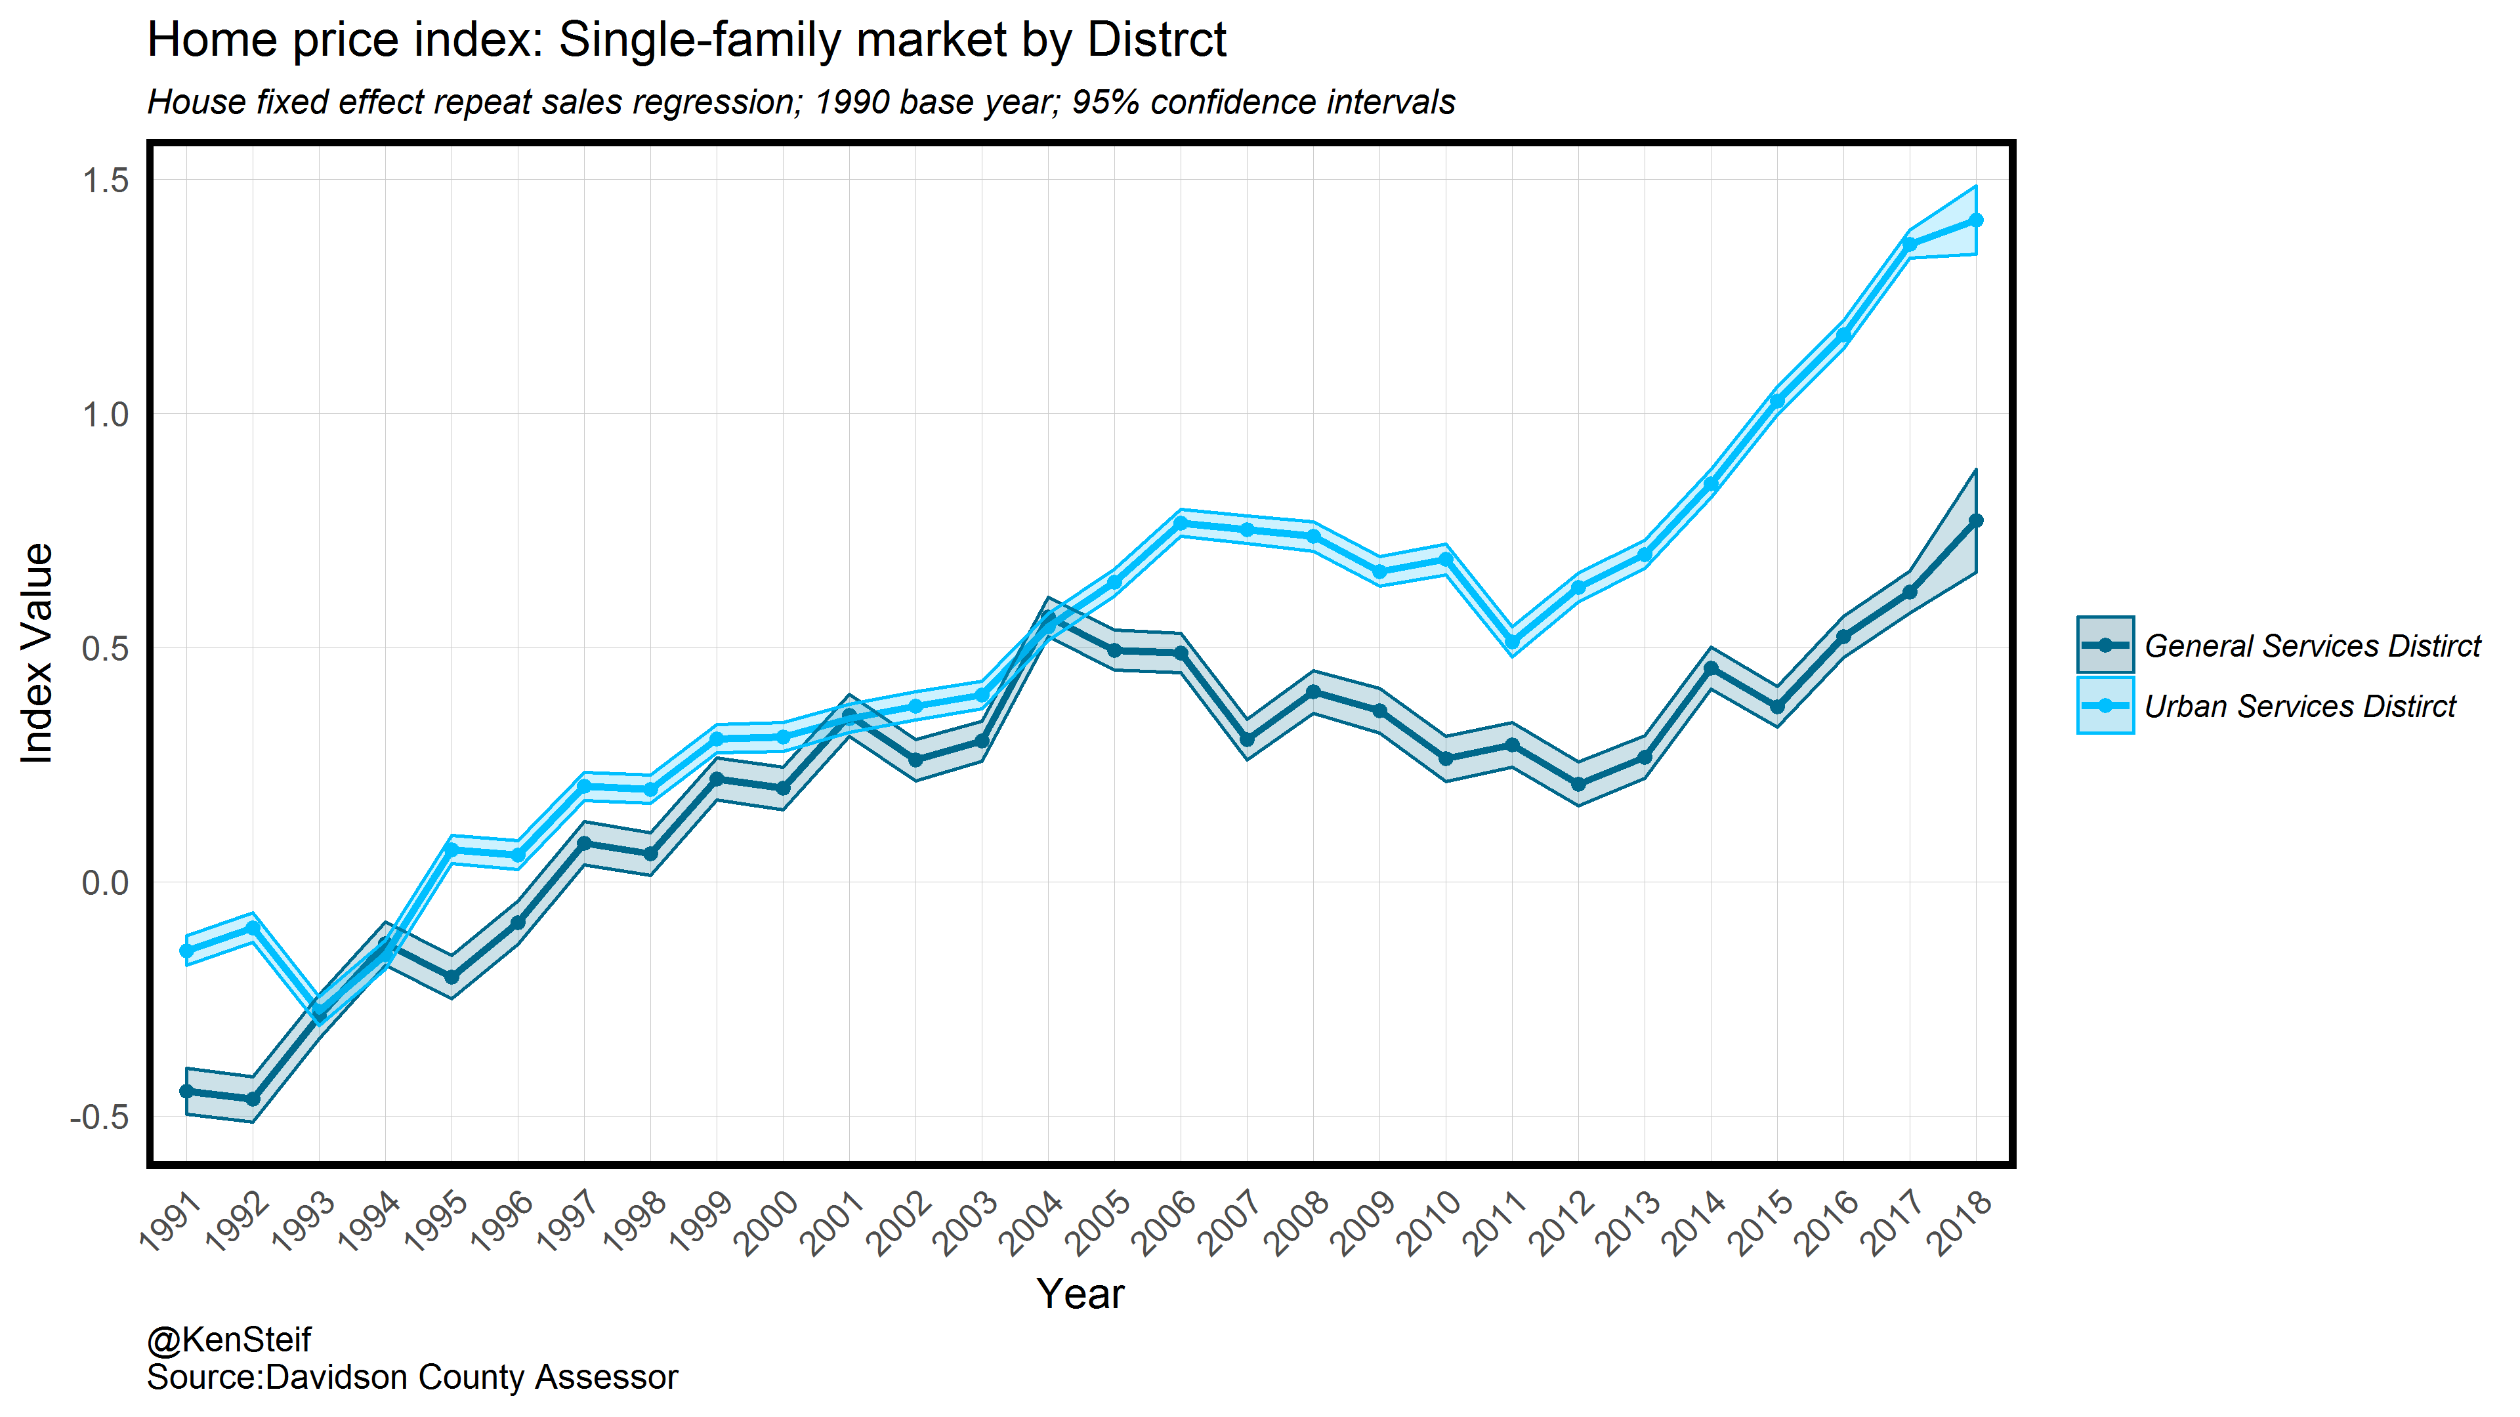
A machine-centric approach to gentrification in Nashville
Hypothesis 1: Households increasingly prefer urban locations over suburban locations.
@KenSteif

Slide 14
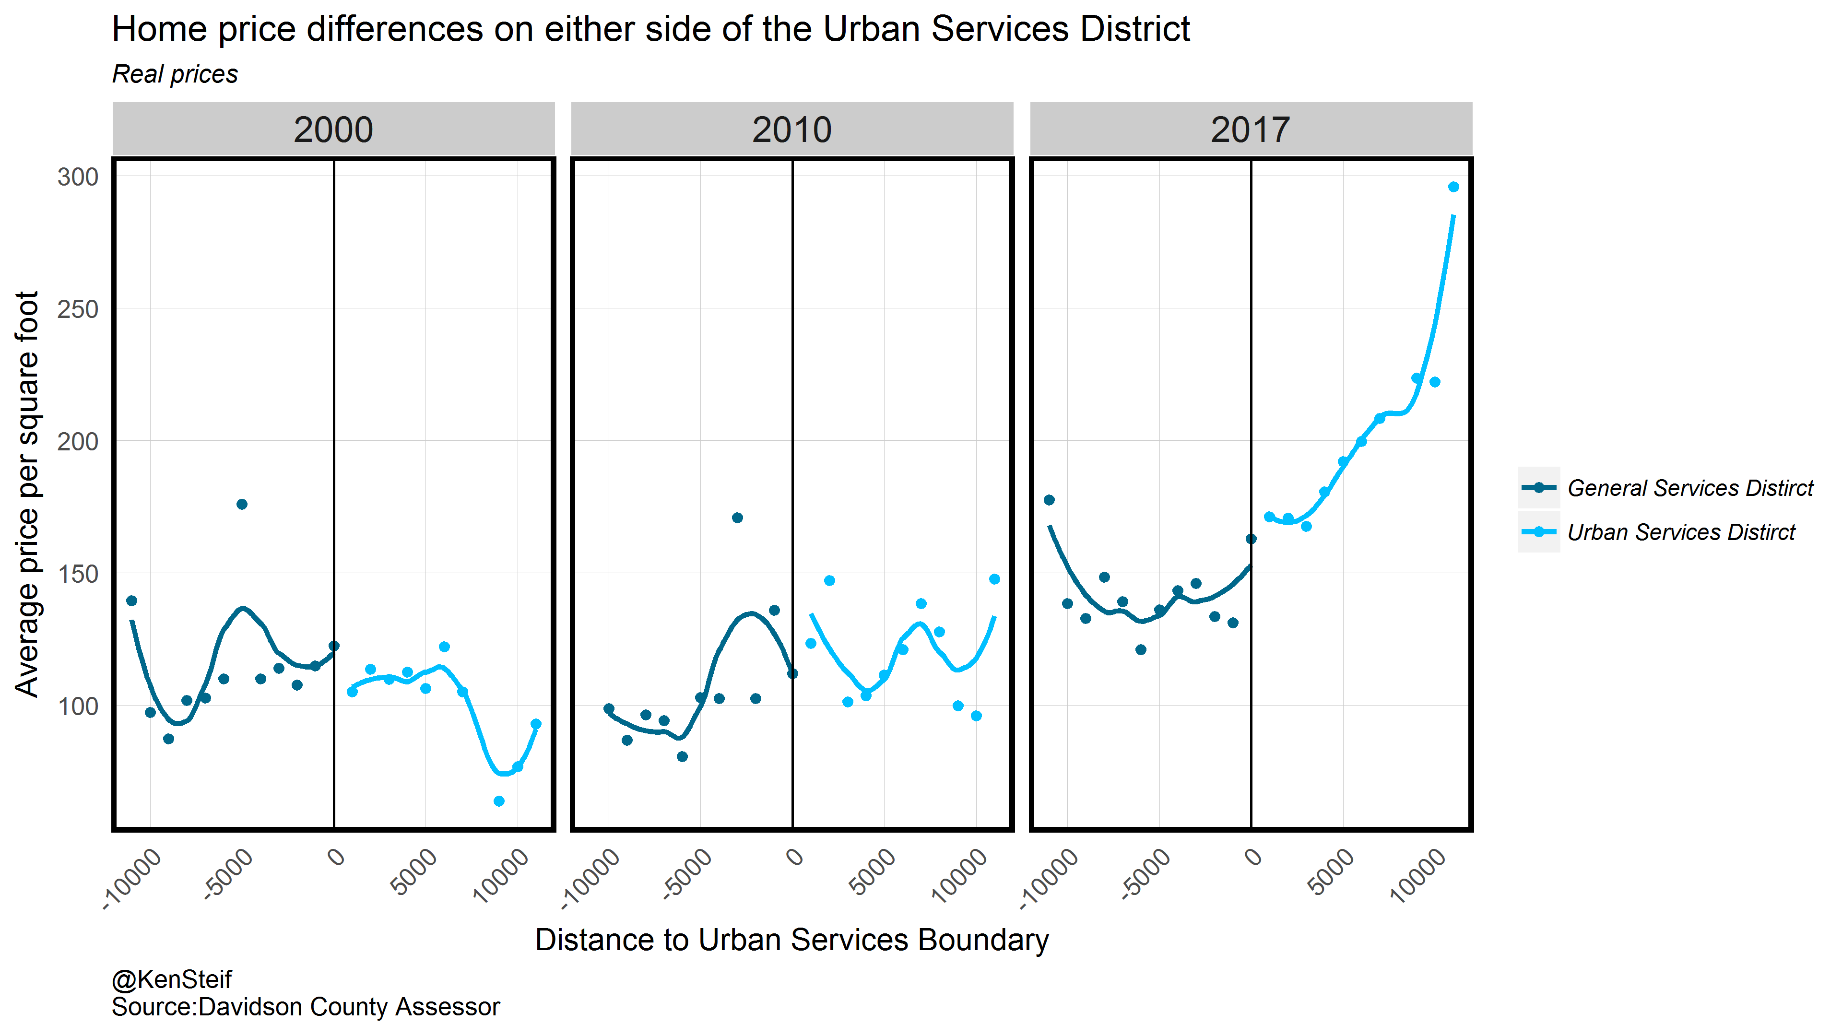
A machine-centric approach to gentrification in Nashville
Hypothesis 2: Households choose urban locations by trading off their willingness to pay for housing with their preference for accessing urban amenities.
@KenSteif

Slide 15
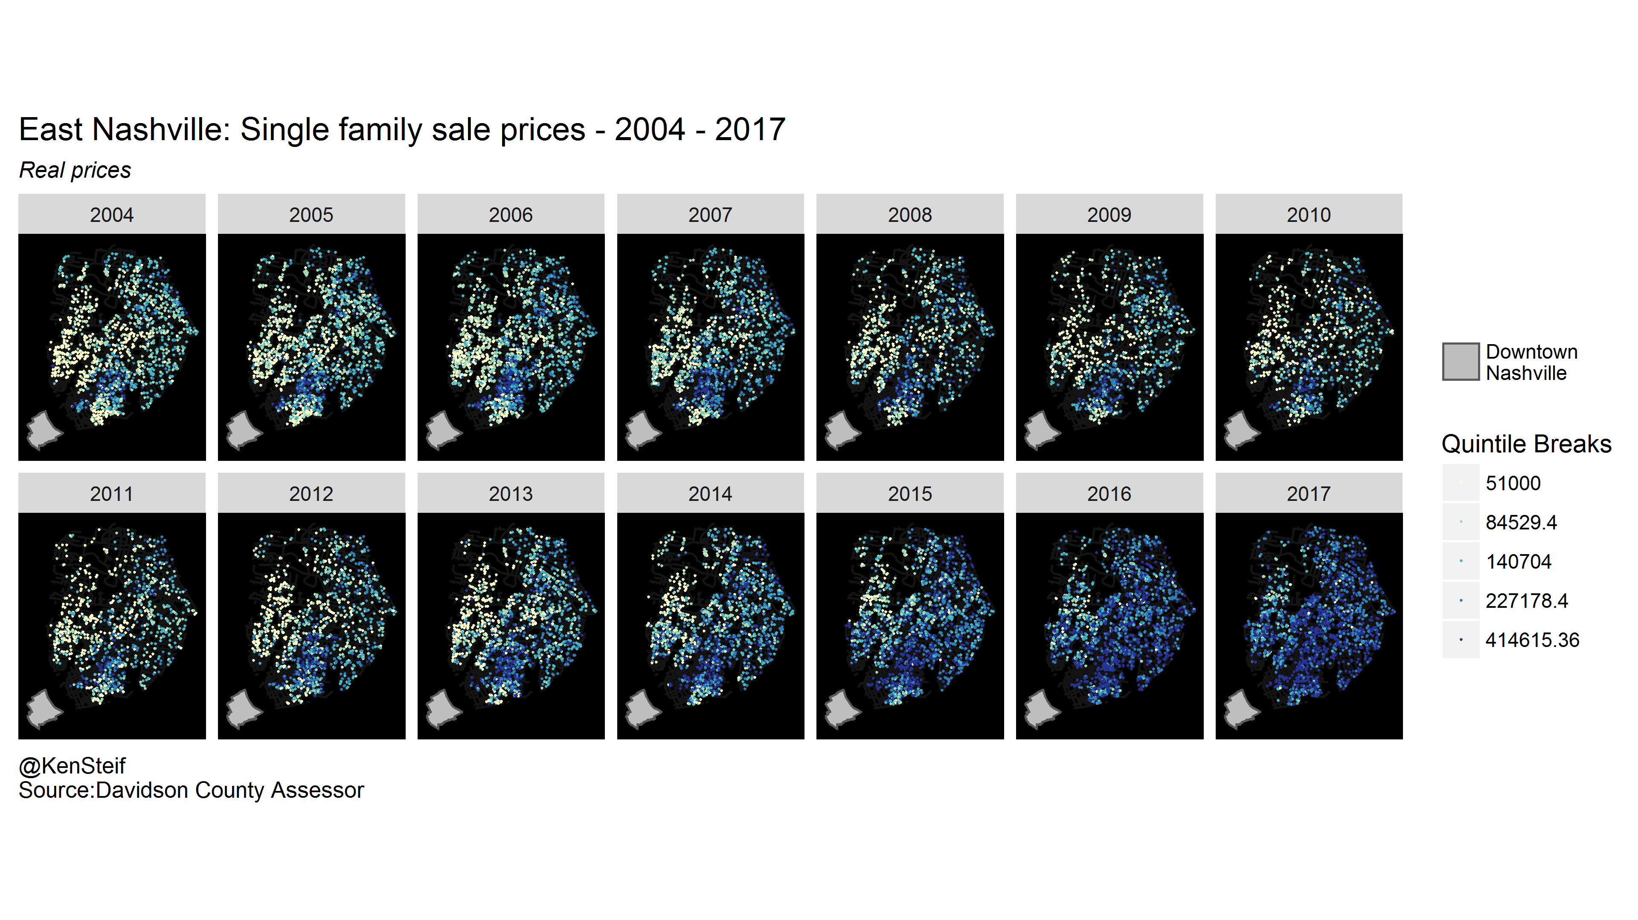
A machine-centric approach to gentrification in Nashville
Hypothesis 2: Households choose urban locations by trading off their willingness to pay for housing with their preference for accessing urban amenities.
@KenSteif

Slide 16
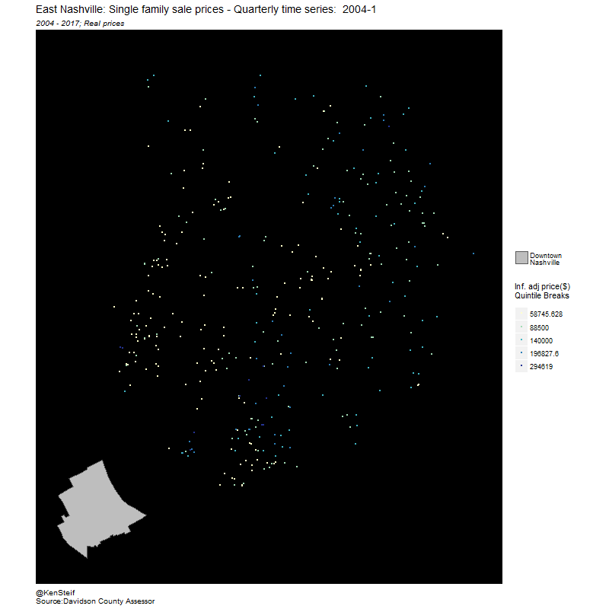
A machine-centric approach to gentrification in Nashville
Hypothesis 2: Households choose urban locations by trading off their willingness to pay for housing with their preference for accessing urban amenities.
@KenSteif

Slide 17
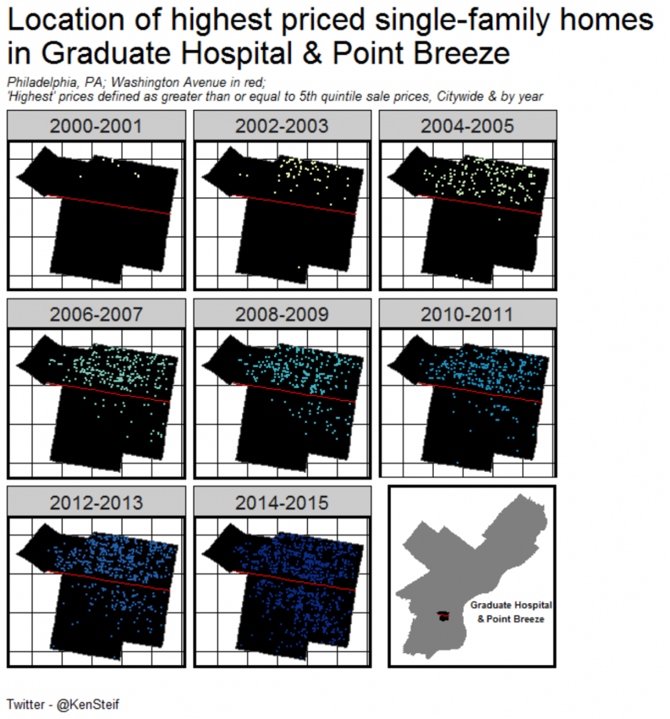
A machine-centric approach to gentrification in Nashville
Hypothesis 2: Households choose urban locations by trading off their willingness to pay for housing with their preference for accessing urban amenities.
@KenSteif

Slide 18
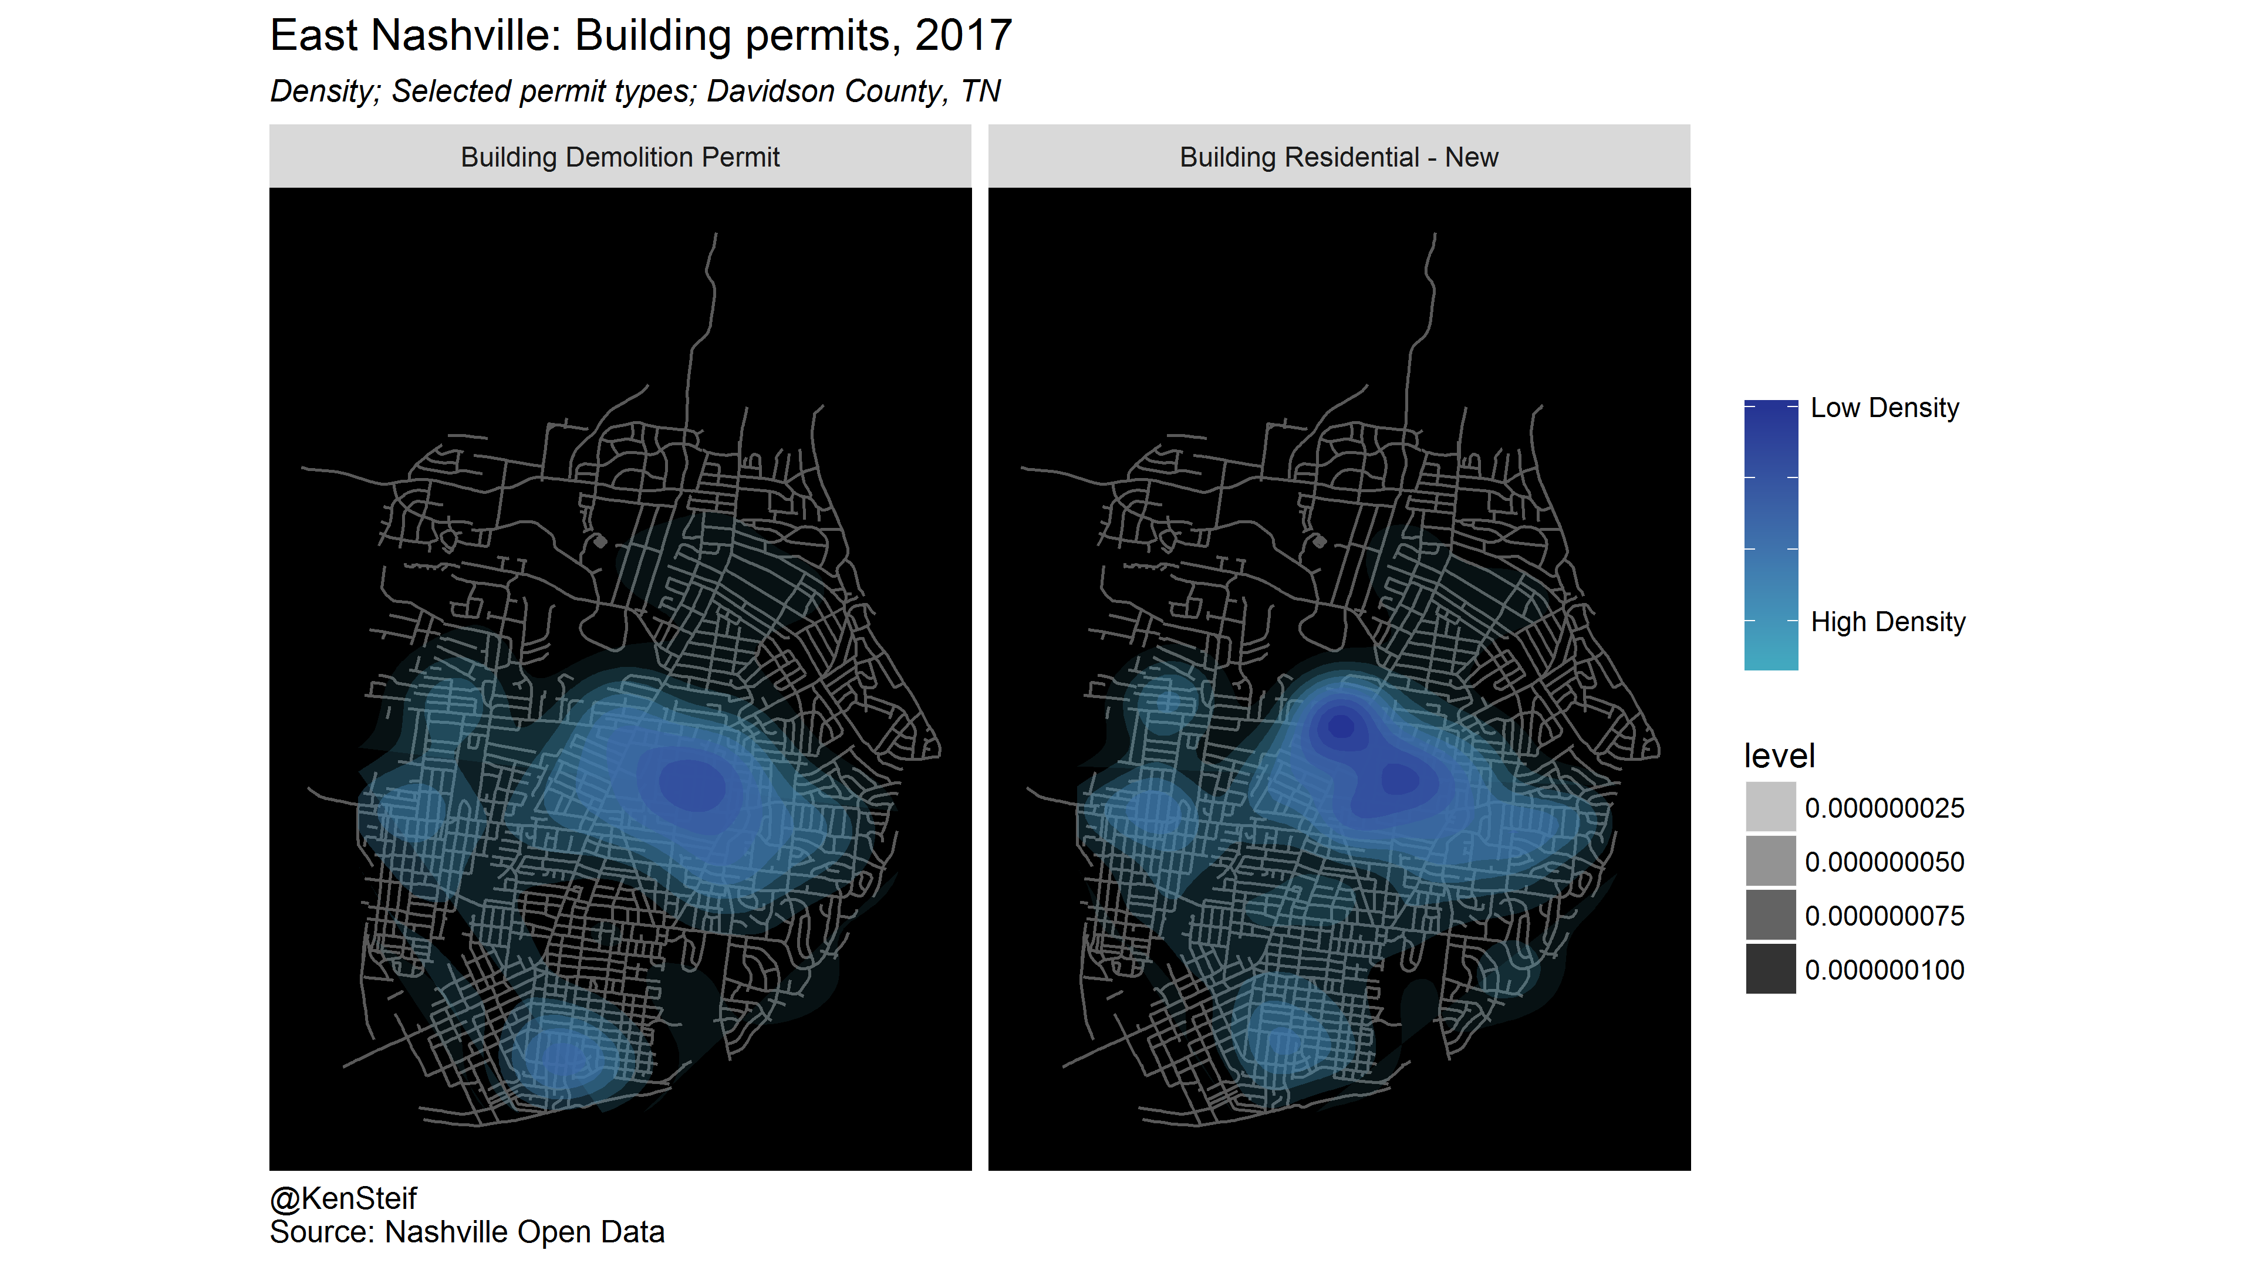
A machine-centric approach to gentrification in Nashville
Hypothesis 2: Households choose urban locations by trading off their willingness to pay for housing with their preference for accessing urban amenities.
@KenSteif

Slide 19
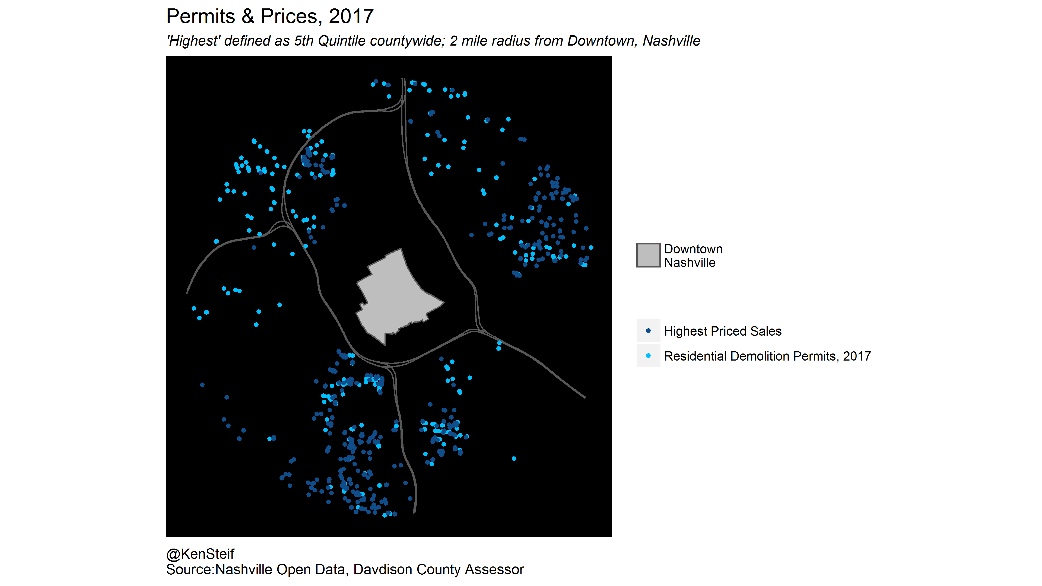
A machine-centric approach to gentrification in Nashville
Hypothesis 2: Households choose urban locations by trading off their willingness to pay for housing with their preference for accessing urban amenities.
@KenSteif

Slide 20
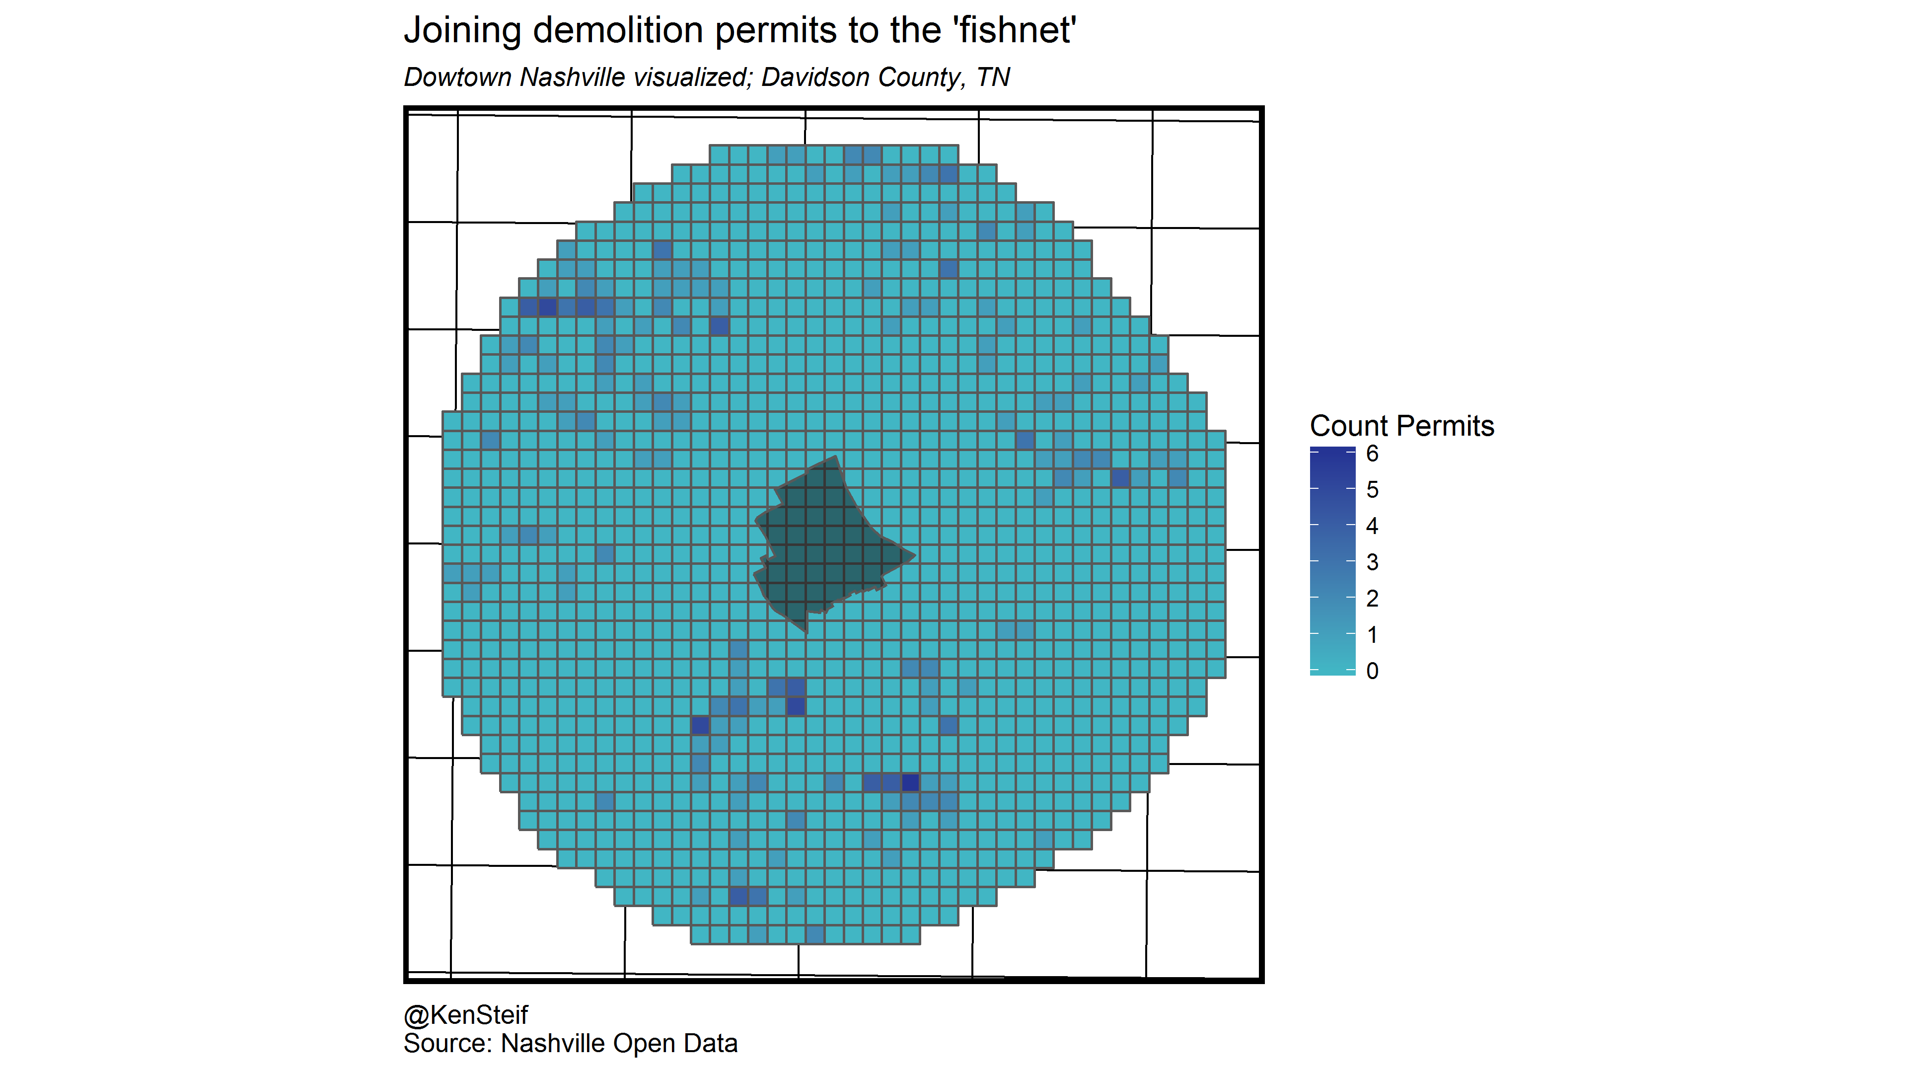
A machine-centric approach to gentrification in Nashville
Hypothesis 2: Households choose urban locations by trading off their willingness to pay for housing with their preference for accessing urban amenities.
@KenSteif

Slide 21
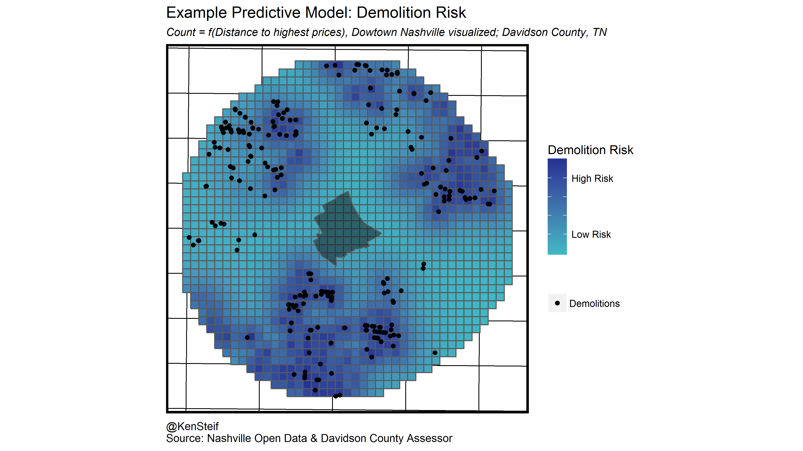
A machine-centric approach to gentrification in Nashville
Hypothesis 2: Households choose urban locations by trading off their willingness to pay for housing with their preference for accessing urban amenities.
@KenSteif

Slide 22
A machine-centric approach to gentrification in Nashville
Thinking about risk associated with ‘neighborhood change’
What events are policy relevant and worth modeling?
Outcome | Individual-level or spatial | Data source | Resource Allocation
Evictions | Both | Licenses & Inspections; Courts; School District | Inspections; Legal assistance
Neighborhood mobility (displacement) | Individual | School District; Assessor; Permits | Rental vouchers; LIHTC
Opioid relapse / Recidivism | Individual | HHS, Medicaid/Medicare, Criminal Justice | Treatment & prevention; Job training
Tax subsidy deed renewal | Both | HUD, State Housing Finance; Assessor | Maintain affordable housing
@KenSteif

Slide 23
A machine-centric approach to gentrification in Nashville
@KenSteif

Slide 24
A machine-centric approach to gentrification in Nashville
Some general policy recommendations for converting data into actionable public
policy intelligence.
1. More Open Data.
2. Data Governance to share, analyze and communicate data and analysis across government agencies.
3. Integrated Data.
4. Work with local academic institutions to embed data-driven decision making in government and non-profit sectors.
@KenSteif

Slide 25
Teaching the machines about gentrification & equity
Ken Steif, Ph.D
Director - Master of Urban Spatial Analysis - Univ. of Pennsylvania
UrbanSpatialAnalysis.com
@KenSteif

